Slide 1
INTRODUCTION TO ACCOUNTING
Event Name/Location
XXth Month

Slide 2
KEY QUESTIONS
What is accounting? (XX mins)
What is financial accounting? (XX mins)
What is the accounting equation? (XX mins)
How do you create financial statements? (XX mins)
What is the matching principle? (XX mins)
How should you categorise expenses? (XX mins)
How should you categorise assets and liabilities? (XX mins)
What is management accounting? (XX mins)
How should you allocate costs? (XX mins)

Slide 3
What is accounting?

Slide 4
OBJECTIVES OF ACCOUNTING
Provide useful financial information about a business
Provide this information to a range of different users

Slide 5
TWO ELEMENTS OF ACCOUNTING
Recording financial transactions as they occur
Summarising transactions to provide information

Slide 6
TWO TYPES OF ACCOUNTING
Financial Accounting
Management Accounting
What are the differences
between the two types?

Slide 7
WHAT IS PREPARED?
Financial Accounting:
Summary financial statements for external users
Management Accounting:
Detailed accounts for internal users

Slide 8
WHEN ARE DOCUMENTS PRODUCED?
Financial Accounting:
Prepared annually
Management Accounting:
Prepared more frequently often on a monthly basis

Slide 9
DO YOU HAVE TO PRODUCE THEM?
Financial Accounting:
Generally legally required
Management Accounting:
Not legally required

Slide 10
WHAT TIME FRAME DO THEY COVER?
Financial Accounting:
Reflect past performance and current position
Management Accounting:
Includes future forecasts as well as reflecting past performance

Slide 11
HOW ARE THEY PREPARED?
Financial Accounting:
In accordance with International Accounting Standards
Management Accounting:
Based on internal requirements

Slide 12
What is financial accounting?

Slide 13
WHAT IS FINANCIAL ACCOUNTING?
Summary statements of financial performance
Concerned with the present and past
Legally required documents
Primarily for external users
Who are the ‘external users’
of financial statements?

Slide 14
FINANCIAL STATEMENTS
INCOME STATEMENT
BALANCE SHEET
CASH FLOW STATEMENT
Reflects performance of a business over a period of time
Reflects position of a business at a certain point in time
Summarises cash inflows and outflows over a period of time
A.K.A
Statement of Profit or Loss
Statement of Financial Position
Statement of Cash Flow

Slide 15
CASH ACCOUNTING
Record income when it is received
Record expenses when you make payment
Profit / (Loss) = Income – Expenditure
Keep records using a ‘cash book’

Slide 16
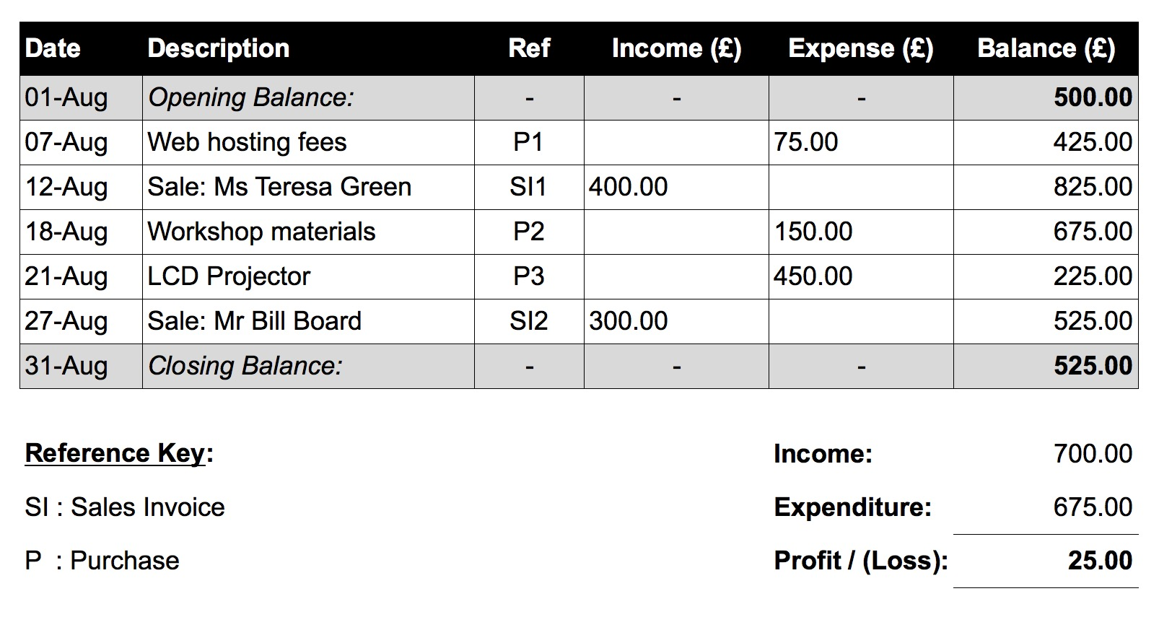
CASH BOOK EXAMPLE

Slide 17
THE LIMITS OF CASH ACCOUNTING
£1m
BUILD HOTEL
RUNNING COSTS
£0
HOTEL SALES
- £0.5m
- £2m

Slide 18
THE LIMITS OF CASH ACCOUNTING
Description
Income
Expenditure
Build Hotel
£2m
Hotel Sales
£1m
Running Costs
£0.5m
TOTAL
£1m
£2.5m
PROFIT / (LOSS): (£1.5m)

Slide 19
THE LIMITS OF CASH ACCOUNTING
Description
Income
Expenditure
Build Hotel
£2m
Hotel Sales
£1m
Running Costs
£0.5m
TOTAL
£1m
£2.5m
PROFIT / (LOSS): (£1.5m)

Slide 20
THE LIMITS OF CASH ACCOUNTING
Cash is very important
However a business is more than its cash flows
Cash accounting works for simple businesses
Cannot capture finances of complex businesses
Use accruals accounting instead

Slide 21
What is the accounting equation?

Slide 22
A BUSINESS HAS THREE THINGS
Assets: what the business owns
Liabilities: what the business owes
Capital: what the shareholders own / are owed

Slide 23
THE ACCOUNTING EQUATION
-
ASSETS
LIABILITIES
=
CAPITAL

Slide 24
THE ACCOUNTING EQUATION
-
ASSETS
LIABILITIES
=
CAPITAL
BUILDINGS
EQUIPMENT
CASH
STOCK
UNPAID CUSTOMER BILLS

Slide 25
THE ACCOUNTING EQUATION
-
ASSETS
LIABILITIES
=
CAPITAL
BUILDINGS
EQUIPMENT
CASH
STOCK
UNPAID CUSTOMER BILLS
BANK LOANS
UNPAID SUPPLIER BILLS
TAXES OWED

Slide 26
THE ACCOUNTING EQUATION
-
ASSETS
LIABILITIES
=
CAPITAL
BUILDINGS
EQUIPMENT
CASH
STOCK
UNPAID CUSTOMER BILLS
BANK LOANS
UNPAID SUPPLIER BILLS
TAXES OWED
MONEY INVESTED
PROFITS / LOSSES
REVENUE
EXPENSES

Slide 27
ASSET, LIABILITY OR CAPITAL?
Work in pairs to review a list of items
Classify items as assets, liabilities or capital
Discuss why you have made your choices

Slide 28
BUILDING A HOTEL
£1m
LOAN
£1m
£1m SHARES
£0
BUILD HOTEL
RUNNING COSTS
INVESTMENT
HOTEL SALES
- £0.5m
- £2m

Slide 29
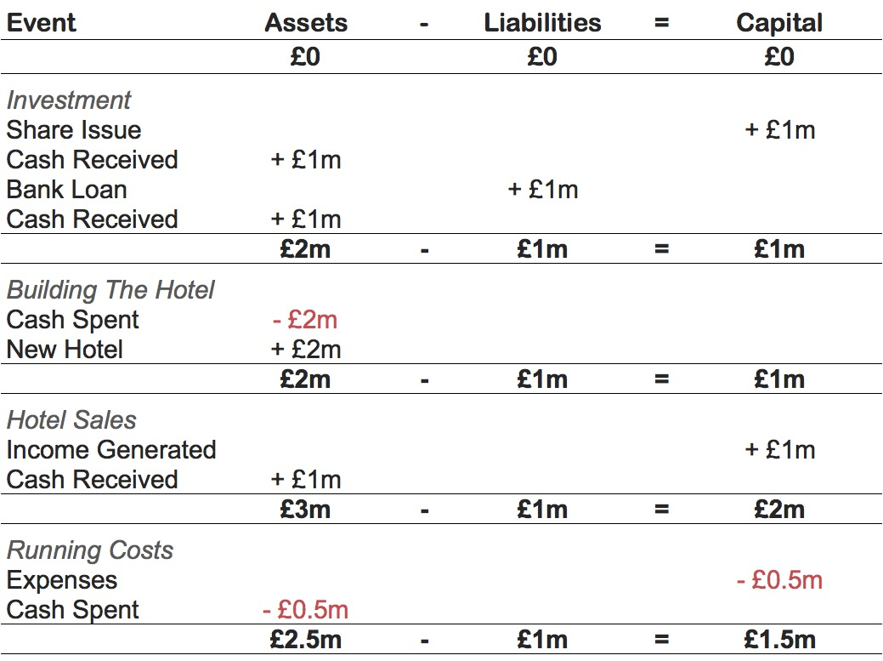

Slide 35
How do you create financial statements?

Slide 36
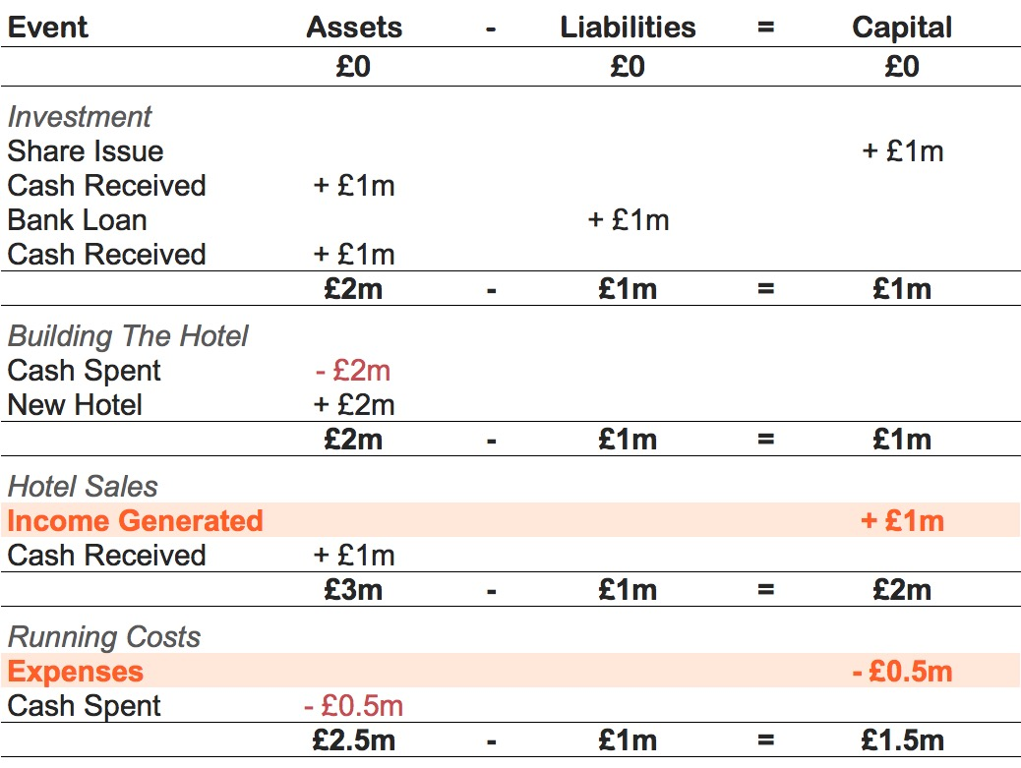

Slide 37
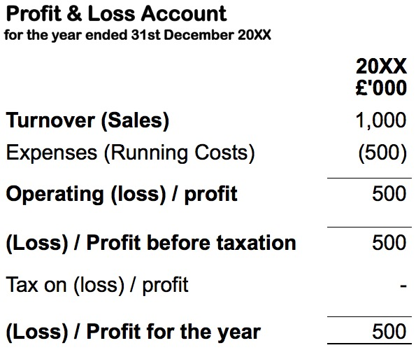

Slide 43
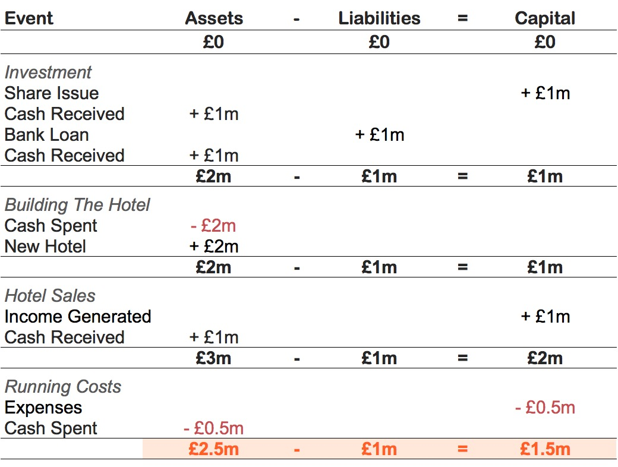

Slide 44
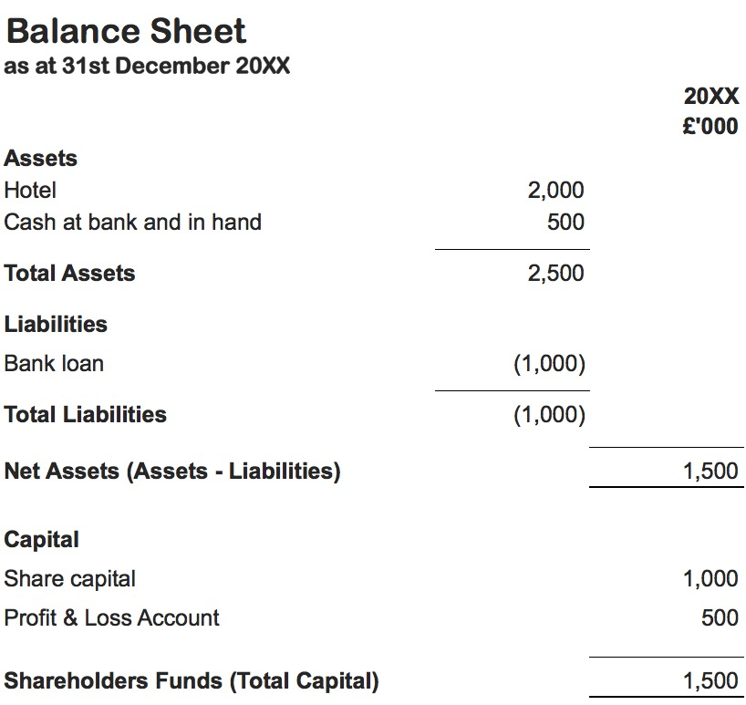

Slide 52
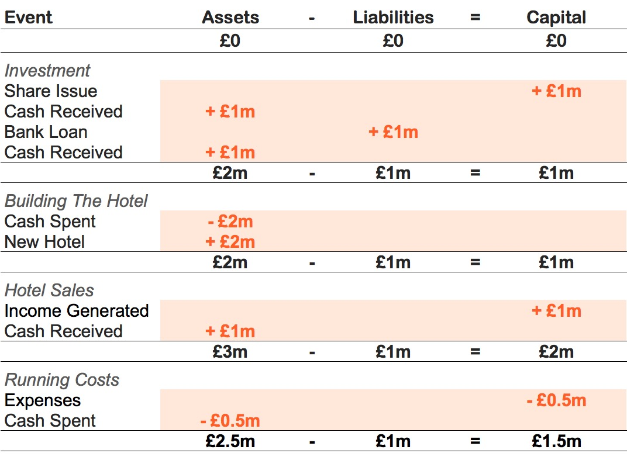

Slide 53
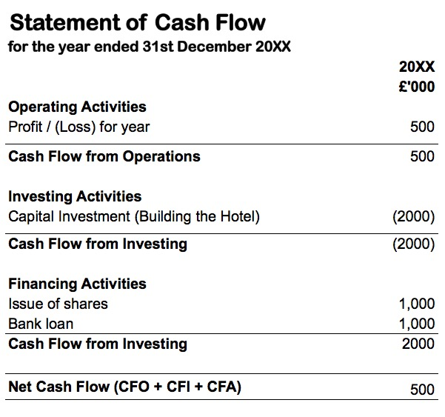

Slide 62
FINANCIAL STATEMENTS
Requirements vary by company type
All companies must produce a balance sheet
Profit and loss required for tax return
Small companies do not need to submit cash flow statements
Some grant funders expect cash flow statements

Slide 63
What is the matching principle?

Slide 64
THE MATCHING PRINCIPLE
Cash Accounting:
Record transactions based on when cash is paid or received
Accruals Accounting:
Record transactions in the period in which they relate to

Slide 65
MATCHING INCOME
Record income when it is earned
Generally record income on the date you send a bill to a customer
Not when the customer pays their bill

Slide 66
HOTEL INCOME EXAMPLE
Dec 30th
Dec 31st
Jan 10th
Invoice
Raised
£1,000
Year
End
Client Pays
£1,000
How much income did the business make in the accounting period?

Slide 67
HOTEL INCOME EXAMPLE
CASH:
ACCRUALS:
£0
£1,000

Slide 68
HOTEL INCOME EXAMPLE
In its first year the hotel business generates £1m of income
In the original example we said that all £1m was received as cash by the end of the accounting period
However this time we will imagine that the hotel has some corporate customers
They are charged by invoice at the end of each month and have 30 days to pay each invoice
At the end of the December we issue invoices worth £100,000 for services they used in December
The invoices are unpaid at the end of the accounting period

Slide 69
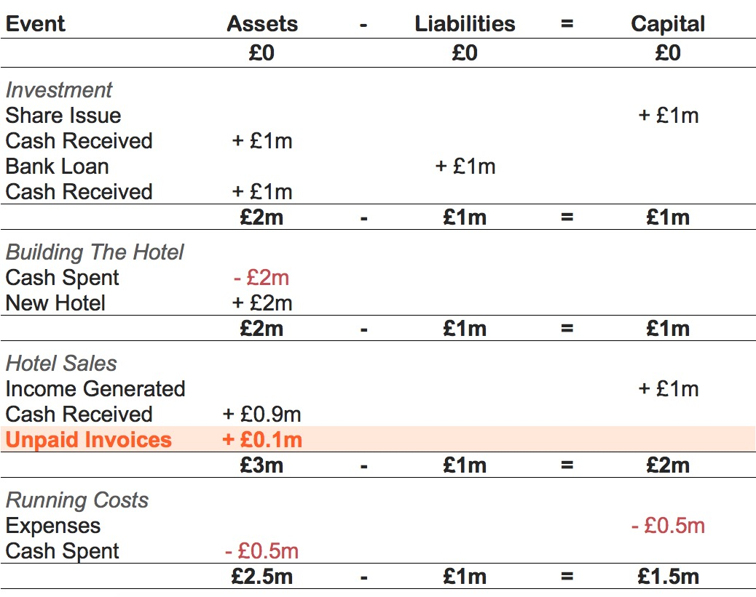

Slide 72
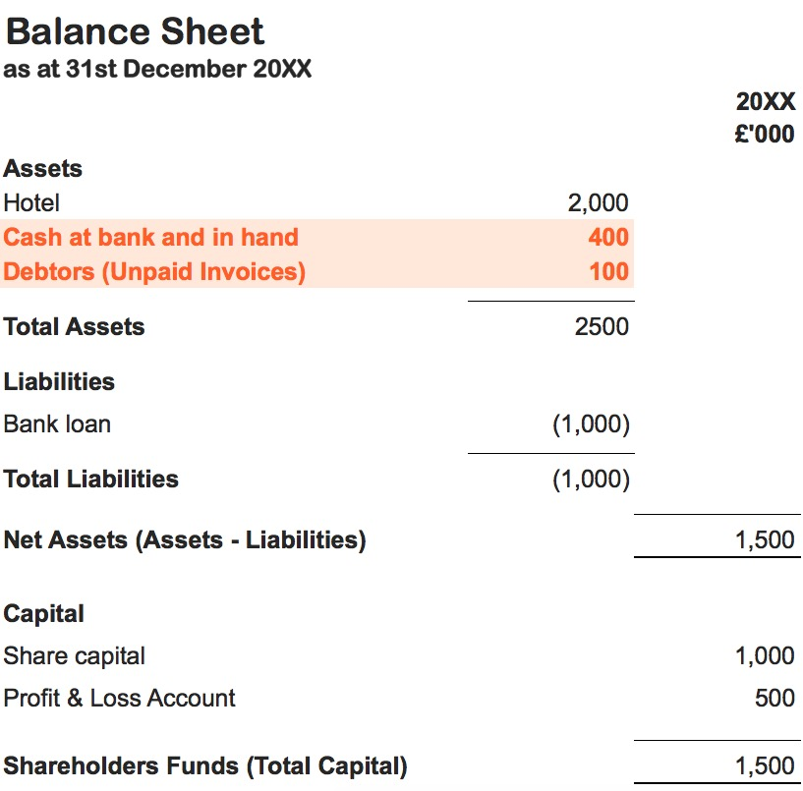

Slide 73
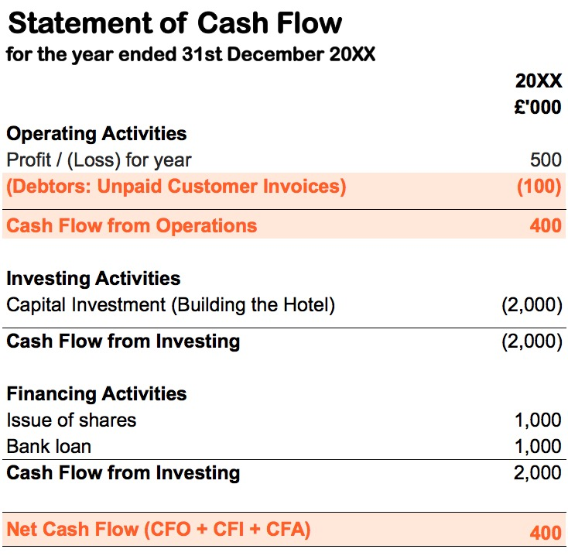

Slide 75
MATCHING EXPENSES
Record expenses when they are incurred
Record expenses in the accounting period they relate to
Even if expenses are not actually paid for in that period

Slide 76
MATCHING EXPENSES EXERCISE
The hotel had running costs (expenses) of £500,000 in its first year
However some suppliers charge the hotel via invoice
These invoices are received at the end of each month for products/services used in the same month
At the end of December the hotel received invoices with a total value of £50,000
The invoices are unpaid at the end of the accounting period
Work in pairs to adjust the financial statement for the business

Slide 77
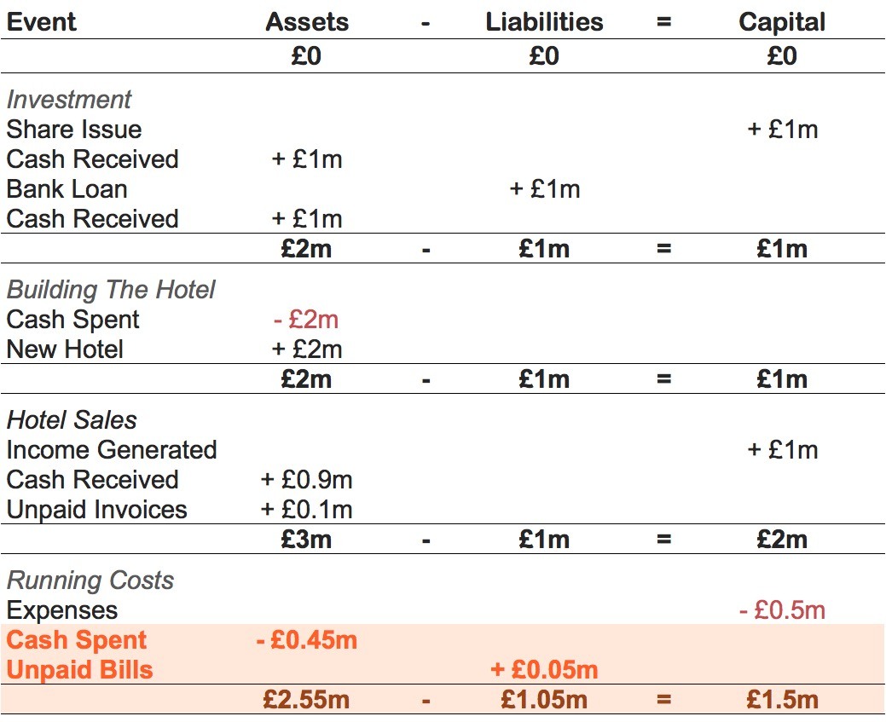

Slide 79
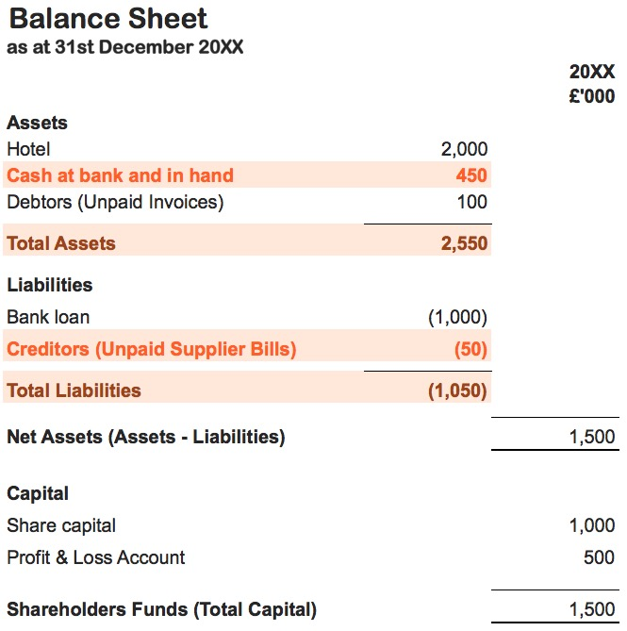

Slide 81
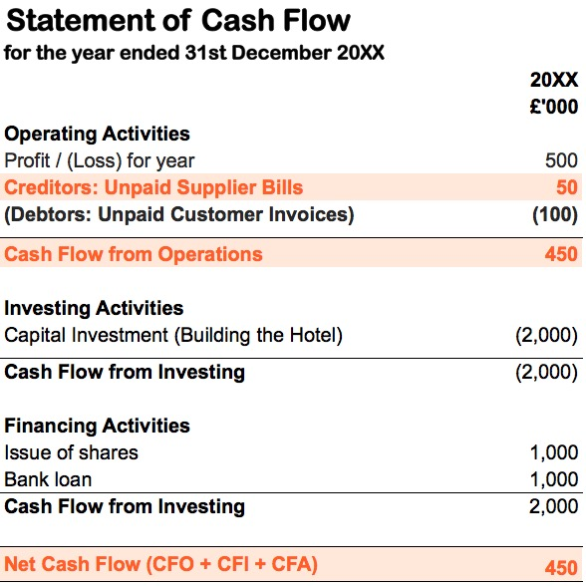

Slide 83
PREPAYMENTS
Only record expenses that relate to a specific accounting period
Expenditure for the next period is a current asset
Specifically known as a pre-payment

Slide 84
HOTEL PREPAYMENT EXAMPLE
Accounting period runs from Jan 1st to Dec 31st
Purchase an insurance policy costing £10,000 per year
This £10,000 is part of the £500,000 running costs
However do not buy policy until July 1st when hotel construction is completed
At December 31st still have six months of cover
£5,000 is expenditure (on P&L account)
£5,000 is a prepayment (on balance sheet)

Slide 85
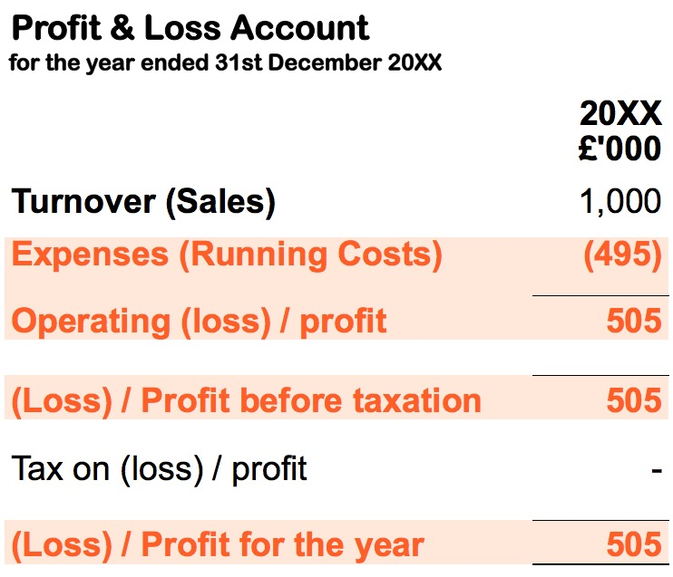

Slide 87
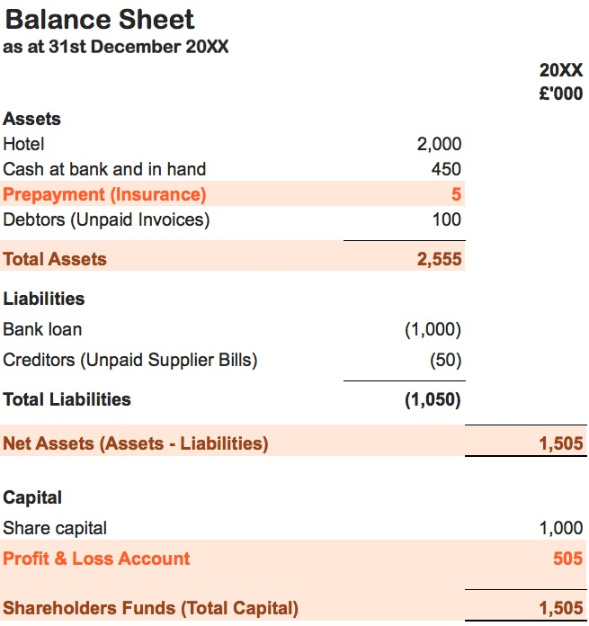

Slide 91
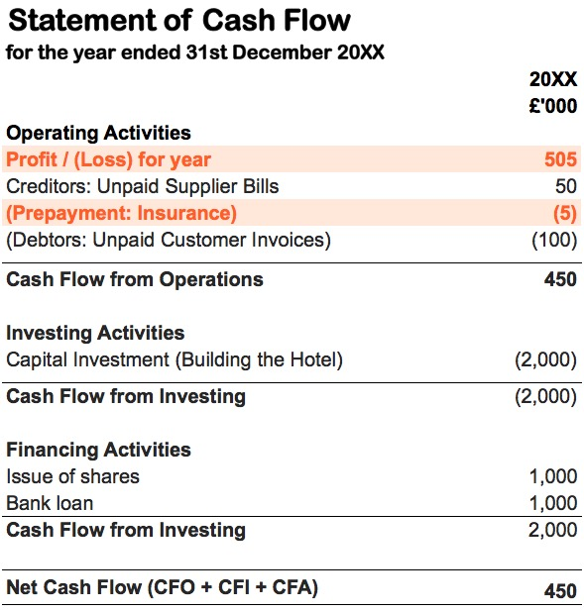

Slide 93
ACCRUED EXPENSES
Expenses incurred but not yet paid for
Not to be confused with the broader concept of ‘accruals accounting’
Accruals are recorded as an expense on P&L
Recorded as a liability on balance sheet

Slide 94
HOTEL ACCRUALS EXERCISE
After the end of each accounting period the hotel pays an accountant to prepare accounts and a tax return
The accountant’s fees are £2,000 and these are paid after end of period
However the fees are still recognised as an expense within the accounting period
Work in pairs to adjust the financial statements

Slide 95
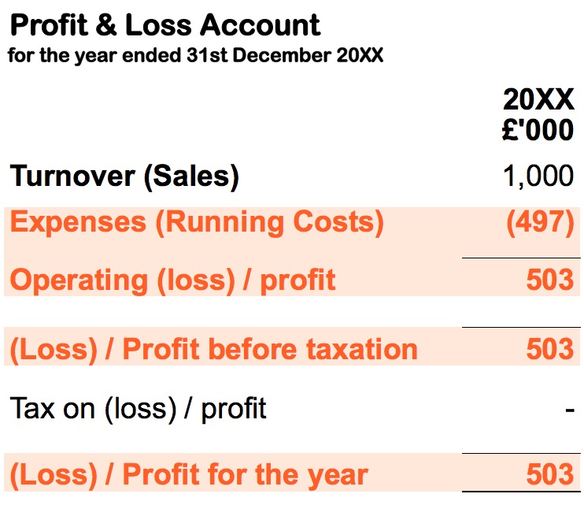

Slide 97
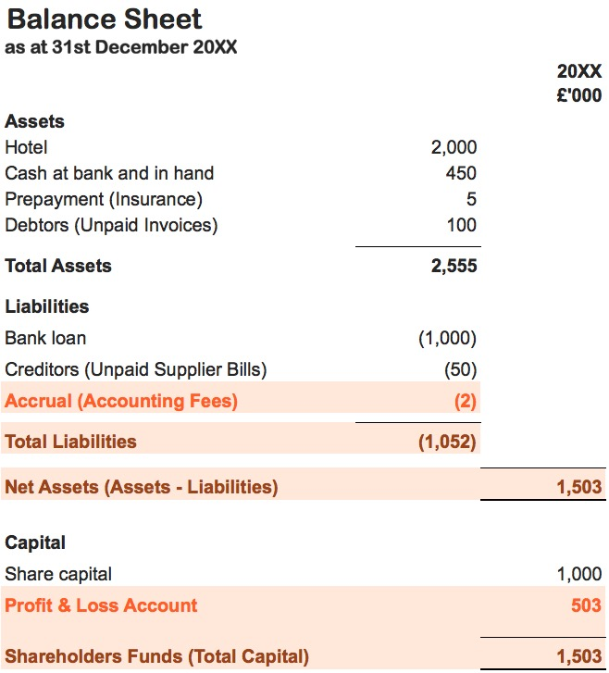

Slide 101
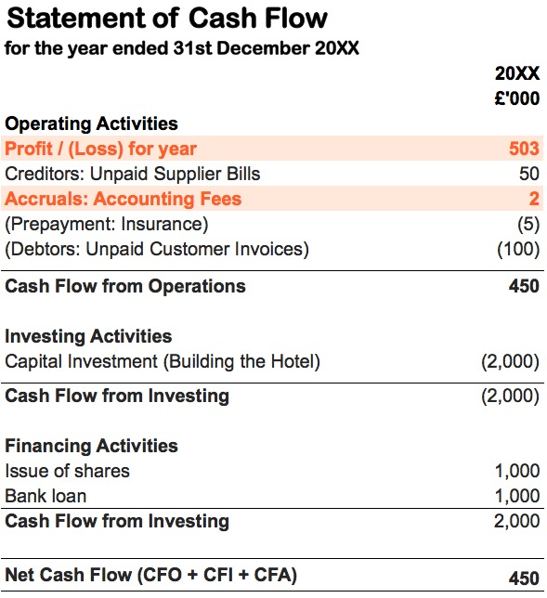

Slide 103
How you should categorise expenses?

Slide 104
TWO TYPES OF EXPENSE
Cost of Sales / Cost of Goods Sold
The direct costs of products and services
Overheads / Administrative Expenses
The indirect costs of running a business

Slide 105
HOTEL EXPENSES EXERCISE
Work in pairs to create two lists
One list of ‘Cost of Sales’ the hotel will incur
One list of ‘Overheads’ the hotel will incur

Slide 106
RECOGNISING EXPENSES
Overheads and cost of sales are separated
Cost of sales is first
Sales minus cost of sales is ‘Gross Profit’
Overheads are then deducted from gross profit
This figure is known as ‘Operating Profit’

Slide 107
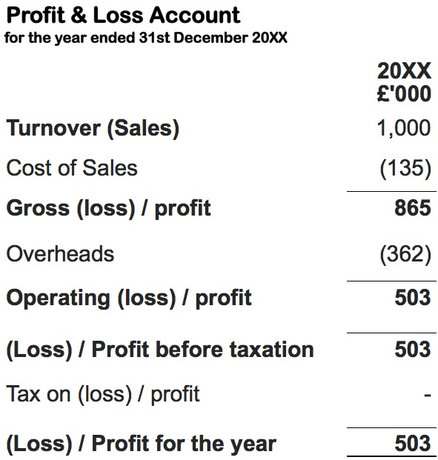

Slide 108
How you should categorise assets and liabilities?

Slide 109
CURRENT AND NON-CURRENT
Current Assets / Liabilities
Have a lifespan of less than one year
Non-current Assets / Liabilities
Have a lifespan of more than one year

Slide 110
CURRENT ASSETS
Cash
Trade debtors (unpaid customer invoices)
Prepayments (e.g. insurance policies)
Stock
What are some examples of current liabilities?

Slide 111
NON-CURRENT ASSETS
Land
Buildings
Equipment
Machinery
What are some examples of non-current liabilities?

Slide 112
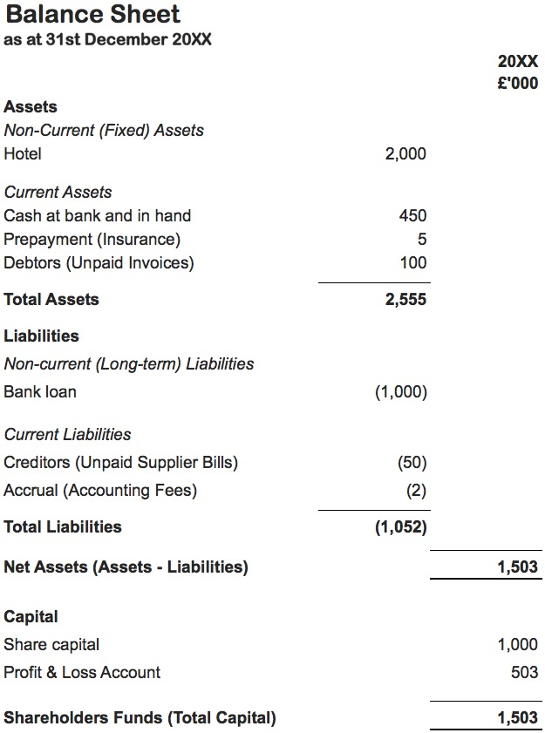

Slide 113
DEPRECIATION
The cost of fixed assets is spread over their expected lifespan
For example a computer costs £1,000
We expect it to have a useful life of 5 years
After 5 years it has an expected value of £0
Computer is a fixed asset on the balance sheet
Each year transfer £200 from the balance sheet to the profit & loss account

Slide 114
DEPRECIATION
There are different methods for calculating depreciation
Only ‘material’ assets need to be depreciated
Land and buildings generally do not depreciate
Discuss your situation with an accountant

Slide 115
What is management accounting?

Slide 116
MANAGEMENT ACCOUNTING
Detailed financial reports for internal use
Relate to past, present and future performance
Not legally required
Created in a format suitable for each business

Slide 117
WHY DO WE DO IT?
To compare expected and actual performance
To create new forecasts of future performance
To make decisions about what to do next
To allocate costs across products and services

Slide 118
How should you allocate costs?

Slide 119
COST ALLOCATION
The cost of a product or service has two parts:
  Cost of sales
  A proportion of business overheads
Different products/services consume overheads at different rates
We need to find appropriate basis for allocating overhead costs

Slide 120
WHY IS THIS IMPORTANT?
Why is it important to allocate overhead costs appropriately?

Slide 121
WHY IS THIS IMPORTANT?
Products and services may not be as profitable as they appear
We need to allocate costs appropriately in order to set prices
We want to ensure we avoid conflict among different members of staff
We need to allow for overhead costs when applying for grants

Slide 122
COST DRIVERS
Need to identify cost drivers
This is a basis for the absorption of overhead costs

Slide 123
COST DRIVER EXAMPLE
A business has two products ‘A’ and ‘B’
The finance manager has a salary of £30,000
How should we divide their salary between the two products?

Slide 124
COST DRIVER EXAMPLE
One of the finance manager’s main jobs is to raise and manage invoices
They raise 100 invoices in a year – a cost of £300 per invoice (£30,000 / 100)
They raise 70 invoices for Product A
They raise 30 invoices to Product B
Allocate £21,000 of cost to Product A
Allocate £9,000 of cost to Product B

Slide 125
COST ALLOCATION EXERCISE
Review the description of the overhead costs for an imaginary social enterprise
Decide how you would allocate these costs between its two products

Slide 126
SUGGESTED ANSWERS
Allocate office costs by FTE headcount
  Project A: £16,000
  Project B: £18,000
Allocate governance costs by expenditure
  Project A: £2,000
  Project B: £3,000

Slide 127
KEEP IN TOUCH
Thank you for coming today, if you have any questions or would like to find out more information, please contact us using the below details:
www.unltd.org.uk/URLHERE
Twitter.com/UnLtd
Facebook.com/UnLtd

